Slide 1



Shaping Future India
NSE Web Scrapping

Slide 2
Group No: 01
Program: PGDM BDA
Names | Enrollment No
Nishi Jamanani | 20251039
Mahendra Kumar | 20251030
Shaily Dave | 20251049
Satya Thakur | 20251048
Meet Rank | 20251033

Slide 3
WEB SCRAPPING [22/12/2025 TO 24/12/2025]
1. Establishing a Secure Connection with NSE Website
2. Accessing Live Market Data via NSE API Endpoint
3. Extracting and Structuring Raw Data
4. Cleaning and Selecting Relevant Market Variables
5. Storing and Exporting the Processed Data

Slide 4
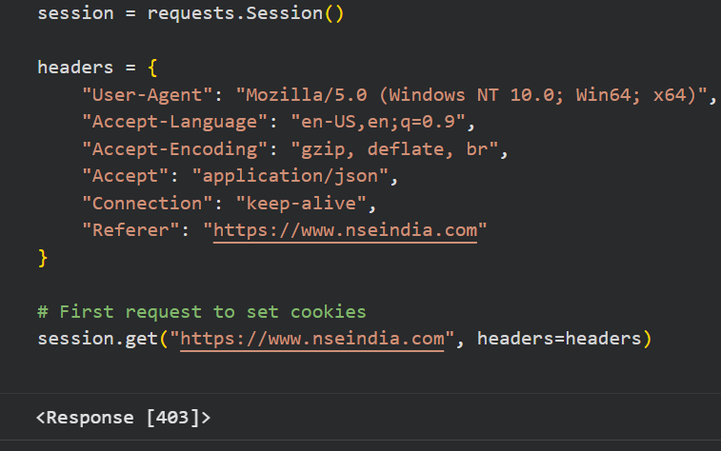
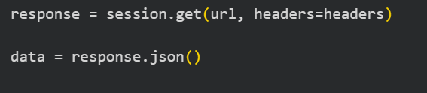
CODES
1. Create session & headers
2. NSE NIFTY 100 API URL
3. Fetch data from NSE

Slide 5
Meaning Of Terms
1. Price Related Columns
2. Movement Related Columns
Open
Change
pChange (%)
Day High
Total Traded Volume
Day Low
Last Price
Previous Close

Slide 6
Calculated Columns
GAP = OPEN-PREVIOUS CLOSE
GAP% = (Open – Previous Closed) / (Previous – Close) x 100
TURNOVER = Traded Volume x Last Price
PRICE POSITION = (Last Price – Day Low) / (Day High – Day Low)

Slide 7

Dashboard

Slide 8
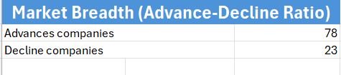
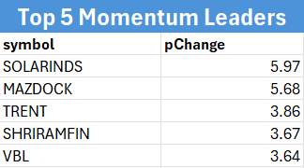
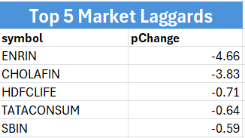
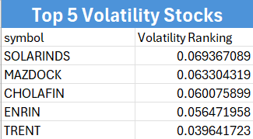
Insights from 22-12-2025
Insight:
The market sentiment is strongly bullish, indicating broad participation from investors rather than gains being limited to a few stocks.
Insight:
These stocks are showing strong short-term momentum, attracting active buying interest.
Insight:
These stocks experienced sharp price movements, indicating higher risk and reward potential.
Insight:
Some stocks faced selling pressure despite overall market strength, indicating stock-specific weakness rather than market-wide issues.

Slide 9
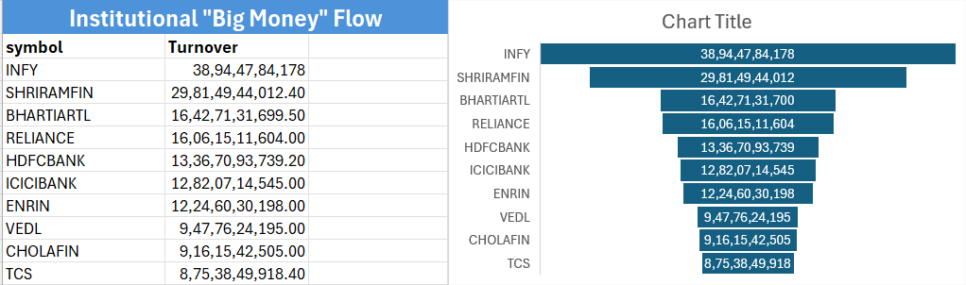
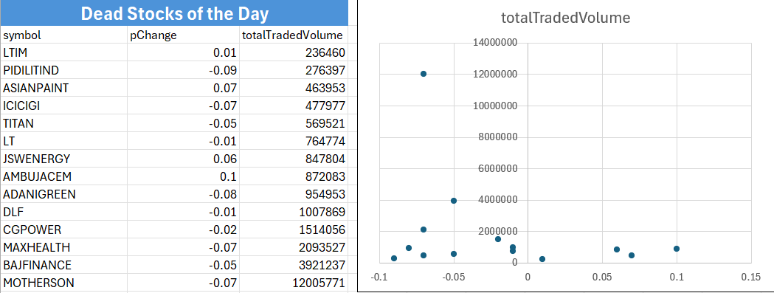
Insight:
High turnover suggests strong interest from large investors such as institutions and mutual funds.
Insight:
These stocks remained inactive or range-bound, reflecting low investor interest for the day.

Slide 10
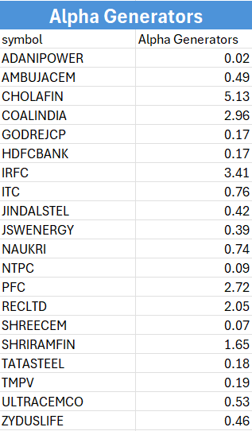

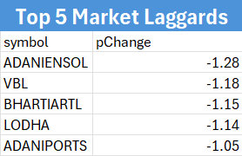
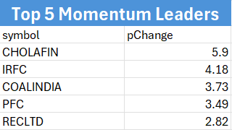
Insights from 23-12-2025
Insight:
The market exhibited a neutral-to-slight bullish bias with a balanced Advance-Decline ratio of 50:49, reflecting selective buying interest across the NIFTY 100.
Insight:
Selling pressure was concentrated in Adani Group entities and select Telecom/FMCG giants like Bharti Airtel and VBL, which closed near their intraday lows.
Insight:
The numerical values in the "Alpha Generators" column represent the excess return percentage generated by each stock relative to its benchmark.
Insight:
CHOLAFIN emerged as the day's top performer with 5.9% gains and a significant Alpha of 5.13, followed closely by momentum in PSU and Metal stocks like IRFC and COALINDIA.

Slide 11
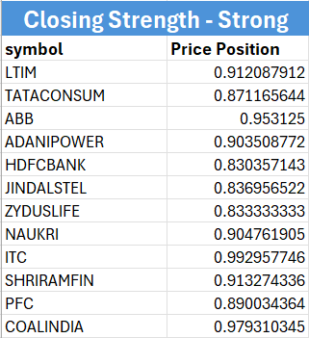
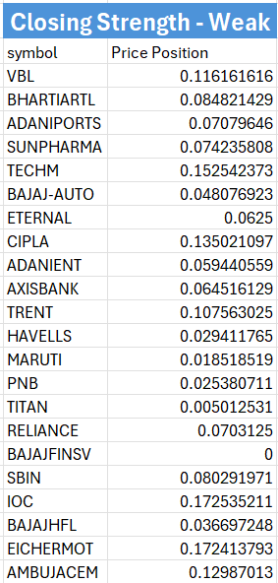
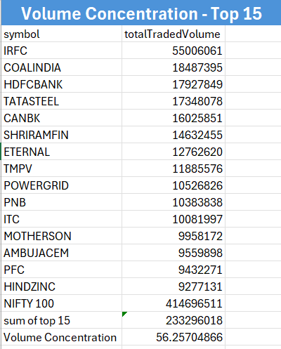
Insight:
High 'Closing Strength' in stocks like ITC and LTIM suggests strong institutional accumulation towards the end of the session, signaling potential positive momentum for the next trading day.
Insight:
Sellers were willing to dump shares even at lower prices right before the bell.
Often, a weak close suggests that the downward momentum might carry over into the next trading session
Anyone who bought during the middle of the day is now "underwater", which can lead to more selling pressure the next morning as they try to exit.
Insight:
Volume Concentration > 50%, the market is concentrated in a 15 stocks. Not all 100 stocks trading.

Slide 12
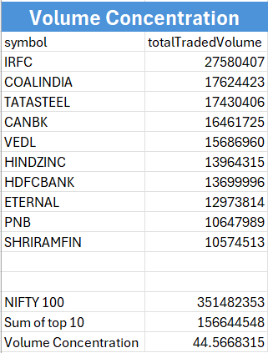

Insights from 24-12-2025
Insights:
More stocks fell than rose in the market.
This shows overall weakness in the market.
Investor sentiment was negative.
Market gains were not supported by most stocks.
Insights:
Trading activity was mainly focused on a few stocks.
Top 10 stocks formed a large part of total volume.
This shows selective buying and selling.
Overall participation was low.

Slide 13
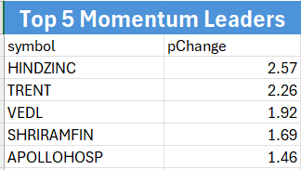
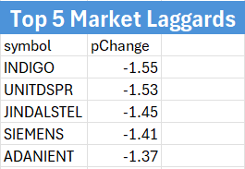
Insights:
Some stocks performed well despite a weak market.
Metals and defensive stocks showed strength.
Price gains were limited but steady.
Buying interest was stock-specific.
Insights:
Several major stocks declined during the session.
Selling pressure was seen in high-risk stocks.
Investors preferred safer stocks.
Market mood remained cautious.

Slide 14
Key Learnings
22 Dec 2025 showed strong bullish sentiment, with 78 out of 100 stocks closing positive and an average price change of ~0.76%.
Market momentum weakened on 23 Dec 2025, as positive and negative stocks were
almost evenly split (50 gainers, 49 losers), indicating consolidation.
24 Dec 2025 reflected bearish sentiment, with 65 stocks closing negative
and an average price change of ~ -0.20%.
Trading volume remained consistently high across all three days,
showing sustained investor participation despite market fluctuations
Price movement patterns suggest a shift from bullish trend to cautious
and corrective market behavior

Slide 15
Conclusion
The project successfully demonstrated end-to-end NSE web scraping
Real-time data was collected, cleaned, and structured efficiently
Dashboards were created to present data in a clear and organized manner
The project strengthened practical application of Big Data Analytics concepts
Overall, the work enhanced technical skills, analytical thinking, and teamwork

Slide 16

Thank You
Thank You

